Slide 1



KARNAVATI UNIVERSITY
Unitedworld Institute of Technology
Summer Application Project
MONEY EXPENSE TRACKER (MoneyMate)
Programme: B. Sc. (Hons.) CS/AIML/DS
Batch: 2022
Guided by:
Guide Name
Designation
UIT, KU
Prepared by:
Student Name (Enrollment No)
B.Sc. (Hons.) CS /AIML/DS

Slide 2


About Project
MERN Stack Technology
MongoDB:
A NoSQL database that stores data in flexible, JSON-like documents. It is used for managing the database layer of the application.
Express.js:
A web application framework for Node.js. It is used for building the server-side application and handling HTTP requests and responses.
React:
A JavaScript library for building user interfaces, particularly single-page applications. It is used for creating the client-side (front-end) of the application.
Node.js:
A JavaScript runtime that allows developers to run JavaScript on the server side. It is used for running the back-end application.

Slide 3
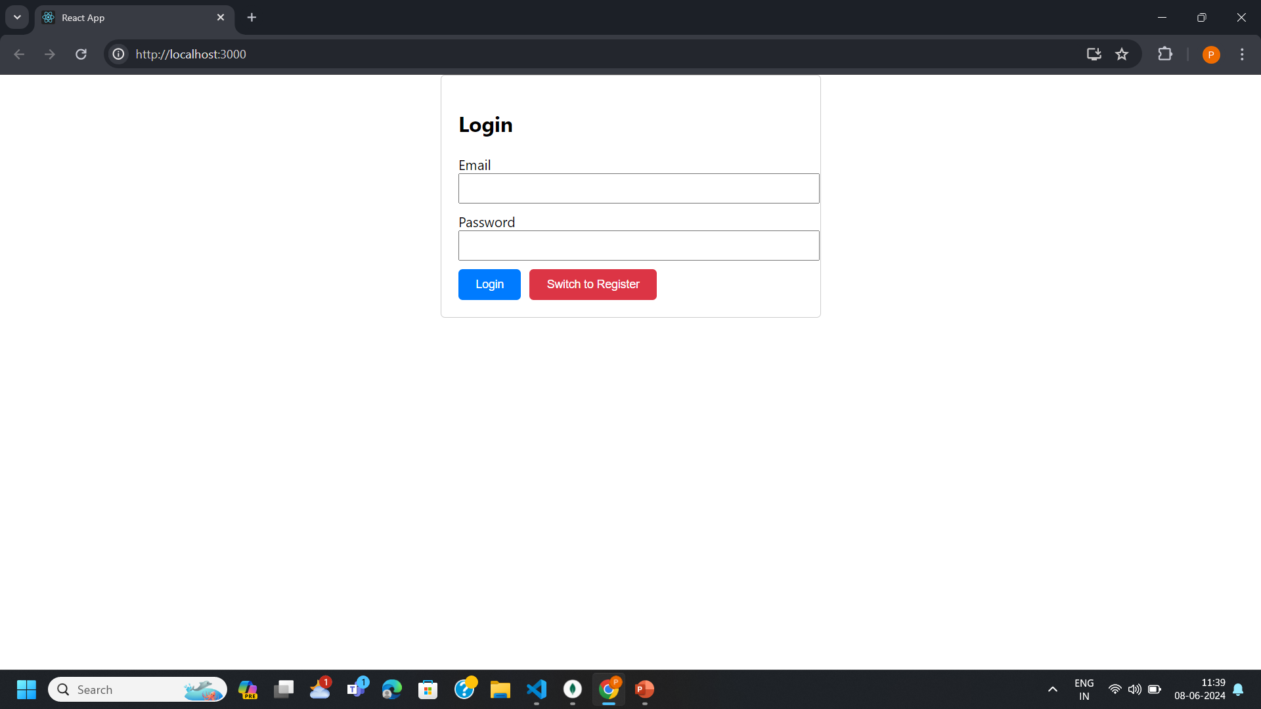
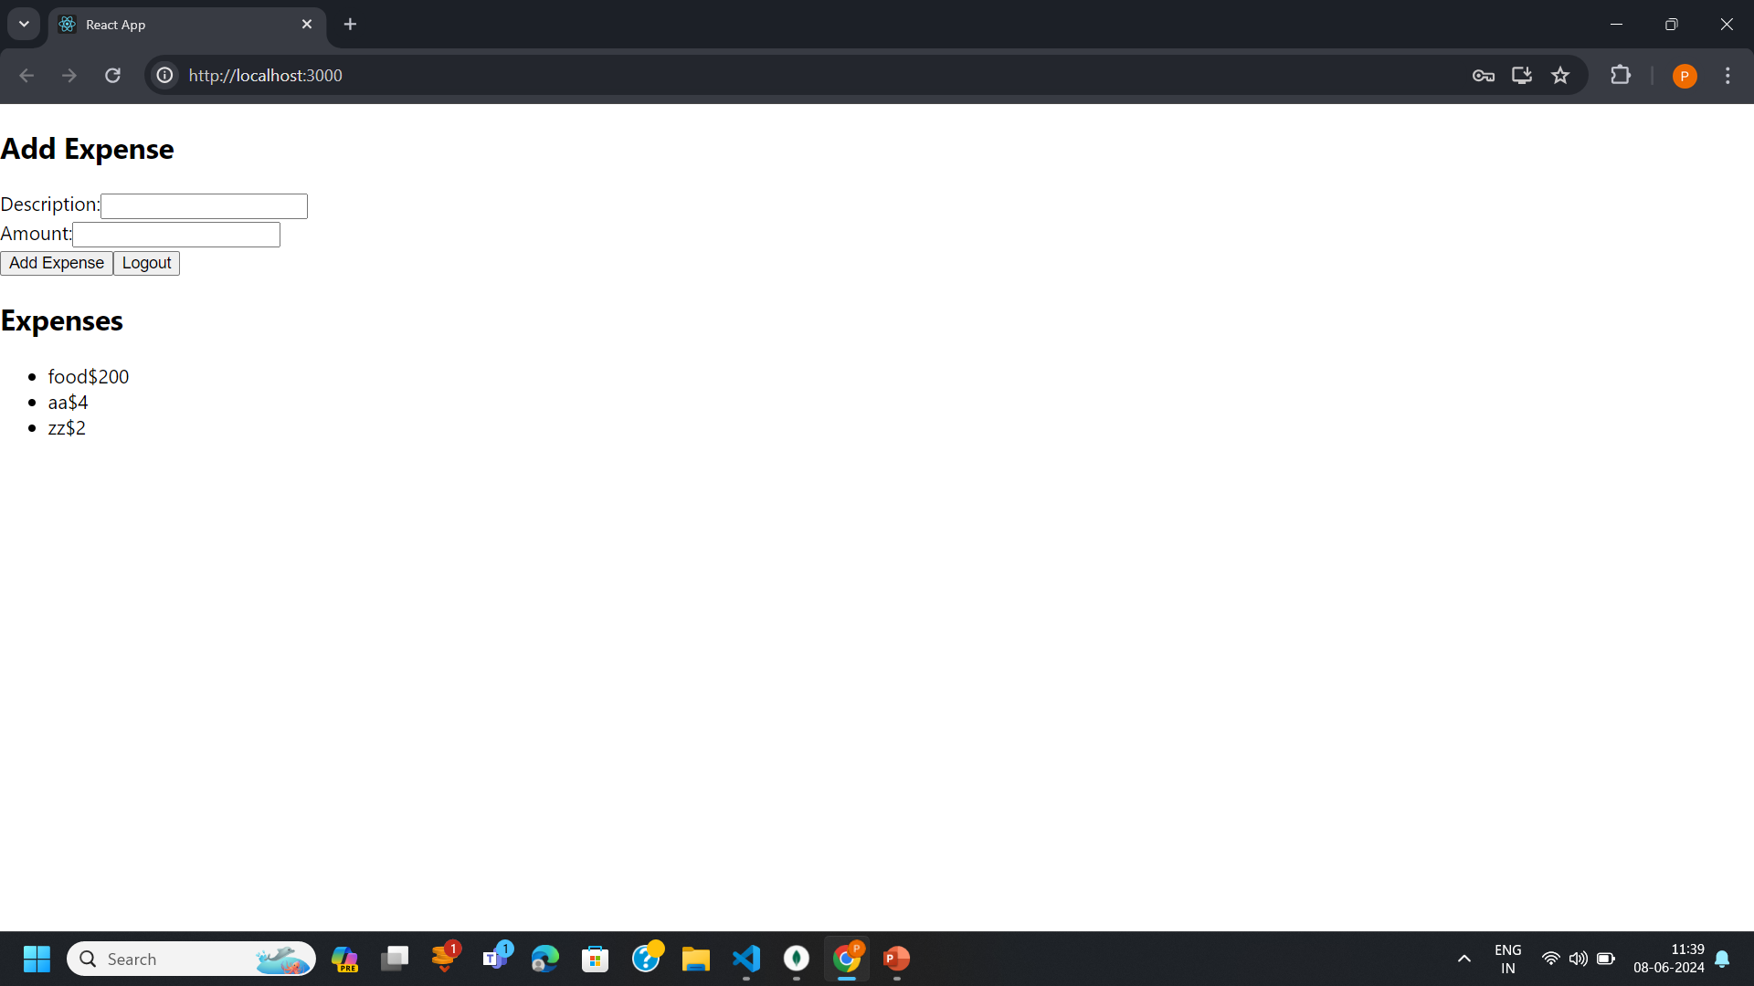
FRONTEND

Slide 4
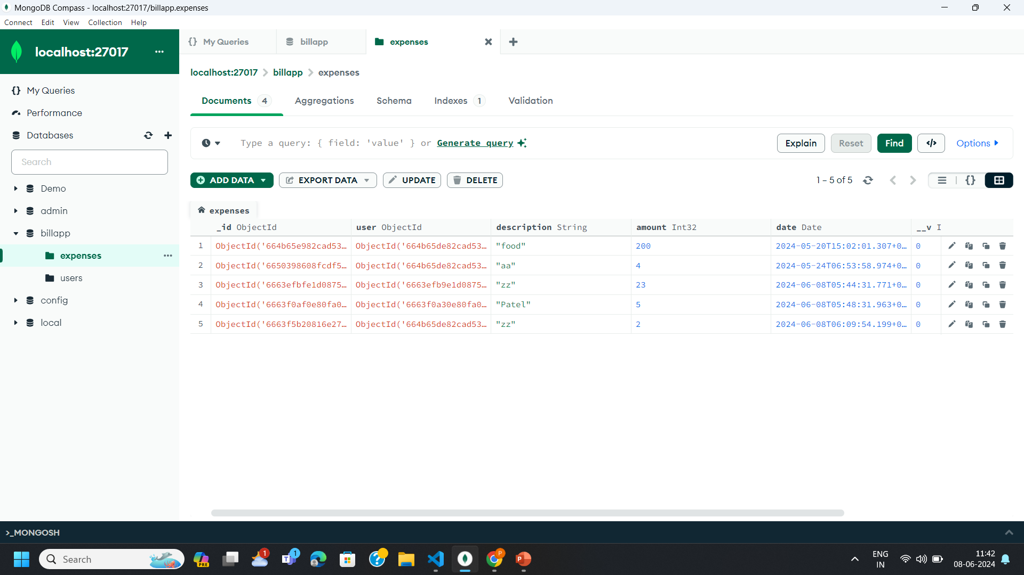
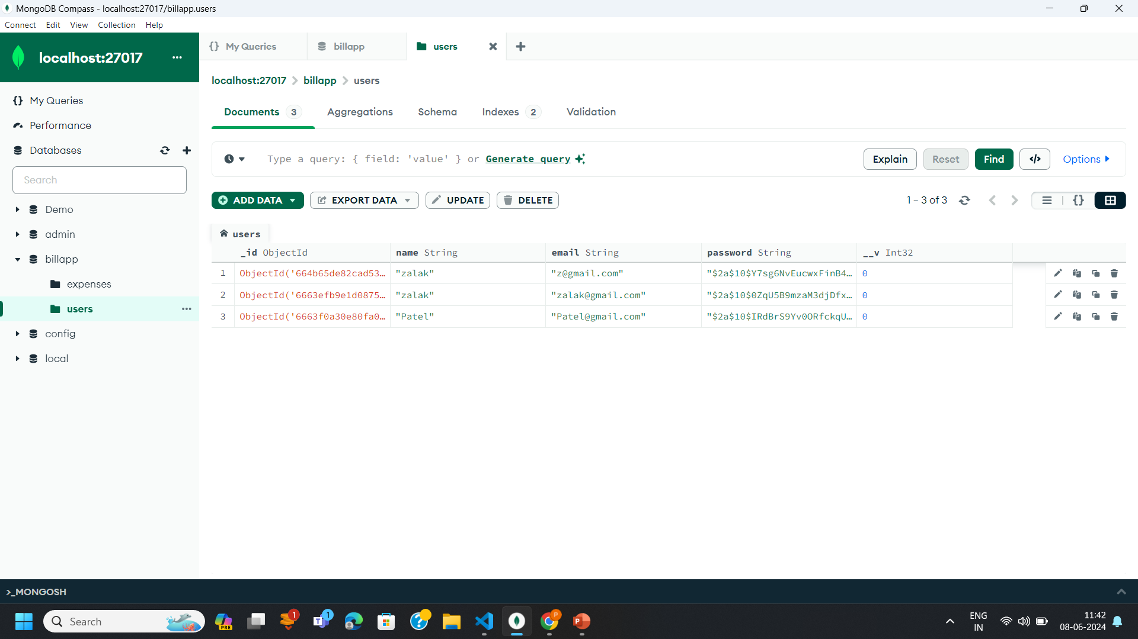
BACKEND:

Slide 5
THANK YOU

